Slide 1
Introduction
This chapter introduces more sophisticated methods for solving sparse matrix problems.
Krylov subspace methods are a class of algorithms that project the problem into a lower dimensional subspace formed by powers of a matrix.
Conjugate gradient method for positive definite matrices.
MINRES for symmetric non-positive definite systems.
GMRES method that applies to general sparse matrices.

Slide 2
Large, Sparse Matrices
Along with other problems, large, sparse matrices occur in the numerical solution of partial differential equations.
The sparsity pattern of a matrix is a plot that shows the presence of nonzeros

Slide 3
Large, Sparse Matrices
Symmetric Positive Definite.
Structural problem.
Symmetric.
Quantum chemistry problem

Slide 4
Large, Sparse Matrices
Non-symmetric.
Computational fluid dynamics problem

Slide 5
Large, Sparse Matrices
The matrices were obtained from the University of Florida Sparse Matrix Collection, maintained by Tim Davis, University of Florida, and Yifan Hu of AT&T Research.
http://www.cise.ufl.edu/research/sparse/matrices/
Matrices can be downloaded from the Web site or accessed by obtaining the UFgui Java interface and running the application on your system.

Slide 6
Sparse Matrix Storage
There are several methods for storing sparse matrices. In each case, only the non-zero elements are stored.
Matrix operations such as multiplication are optimized.

Slide 7
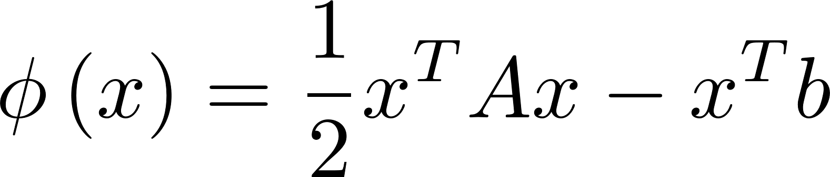
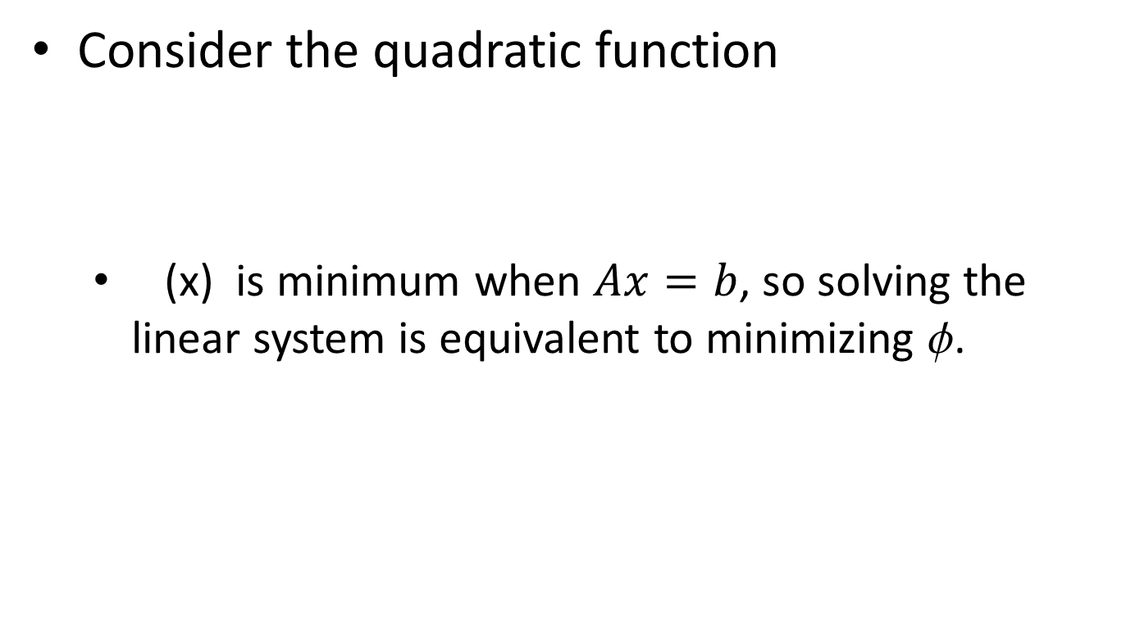
The Conjugate Gradient Method
Consider the quadratic function
(x) is minimum when $Ax=b$, so solving the linear system is equivalent to minimizing .

Slide 8
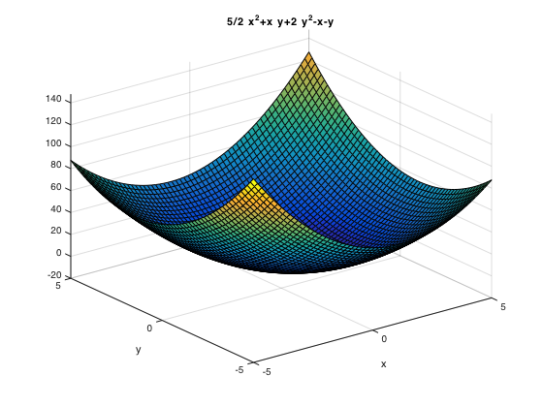
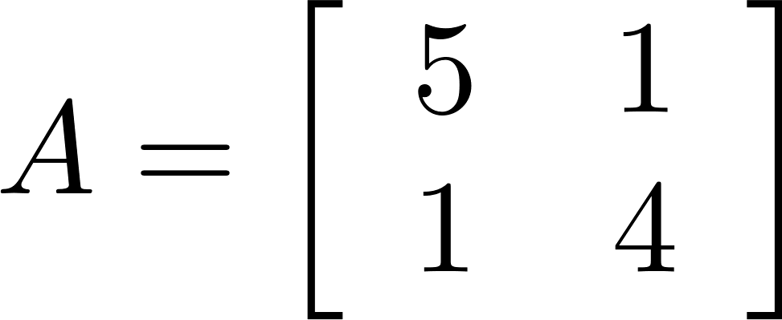
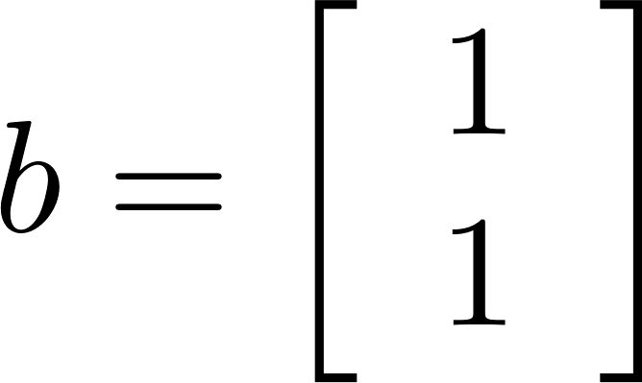

Graph of $∅\left(x\right)$

Slide 9
Level Sets
A level set is a curve along which a function has a constant value.
For a function of two variables, level sets are often called contour lines.

Slide 10
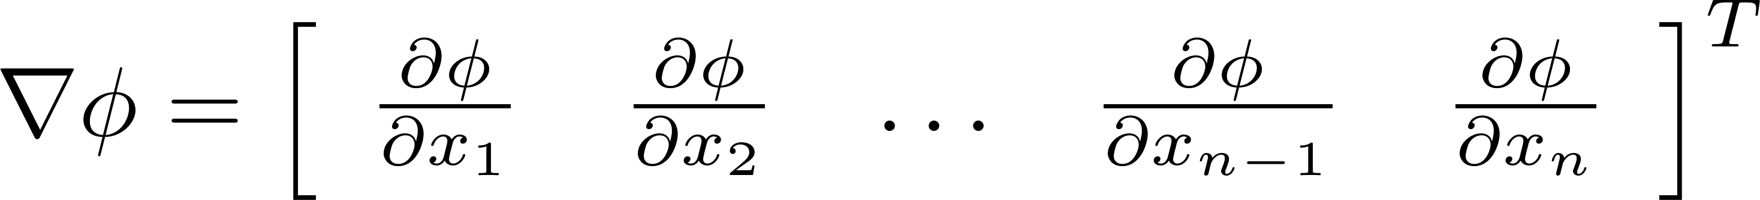
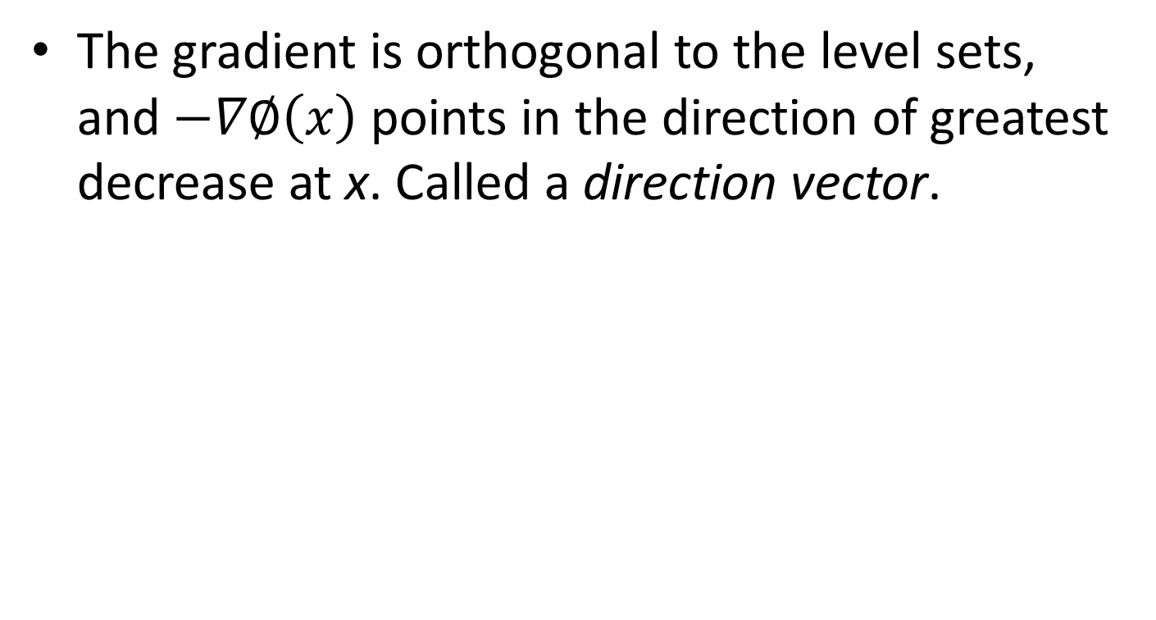
The Gradient
The gradient is orthogonal to the level sets, and $−∇∅\left(x\right)$ points in the direction of greatest decrease at x. Called a direction vector.
Gradient and contour lines

Slide 11
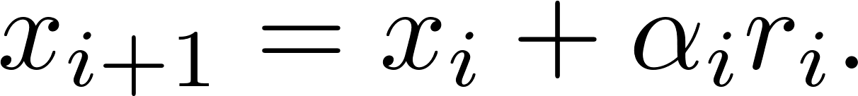
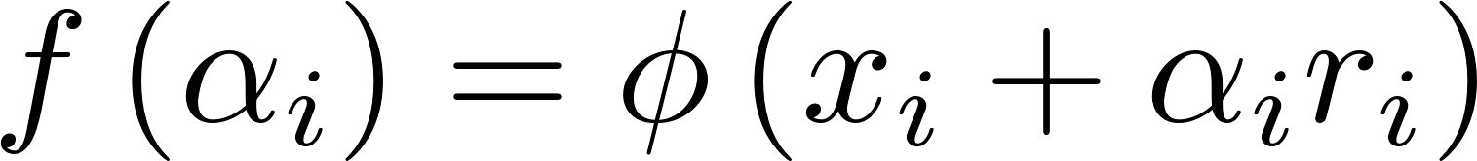
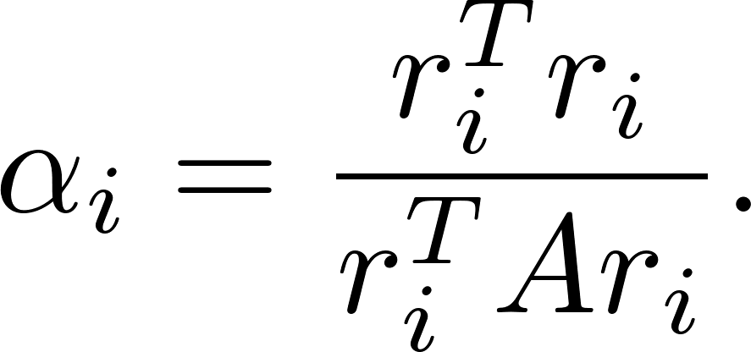
Steepest Descent
In steepest descent, the minimum value is found by starting at an initial point and descending toward x_{min} (the solution of Ax=b ). Descend in the direction of the negative of the gradient, which is the residual r_{i} = b - Ax_{i}.
Let Then, is a minimum when Step from x_{i} to , and then use x_{i+1} and r_{i+1} to compute , the next point downward toward the minimum.

Slide 12
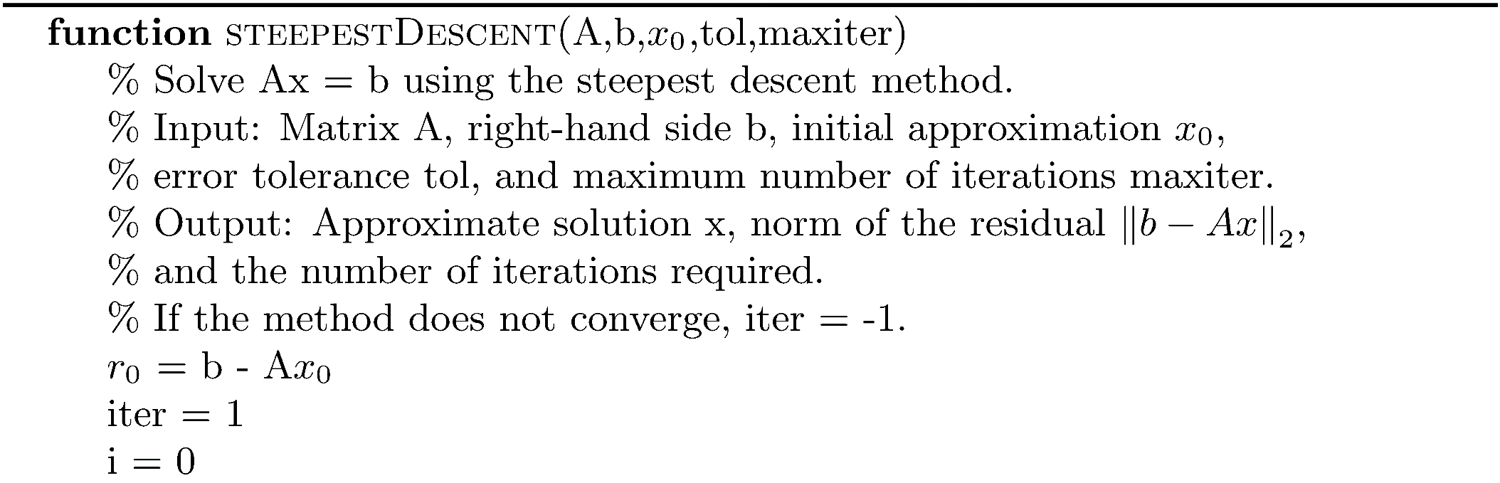
Algorithm steepestDescent

Slide 13
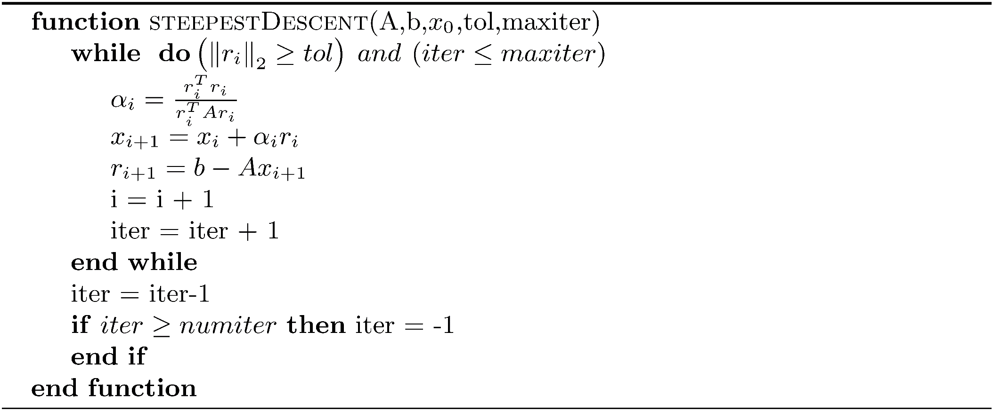
Algorithm steepestDescent
Always converges, but if is large, convergence is very slow.

Slide 14
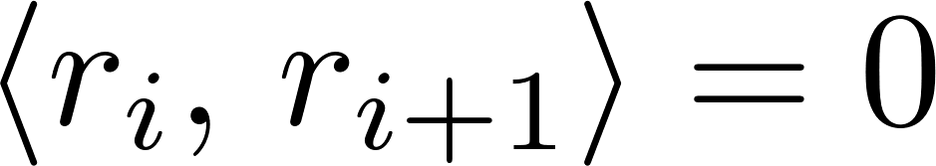
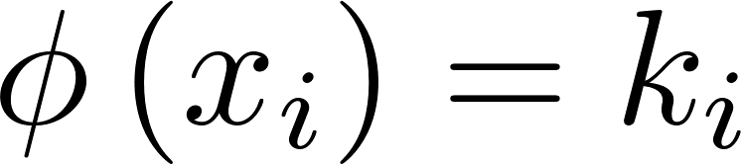
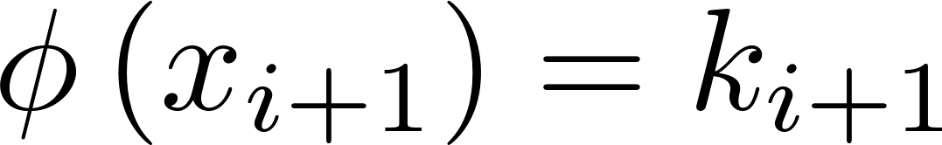
Geometrical Analysis of Steepest Descent
For any n × n matrix, successive search directions, r_{i} , are orthogonal ( ).
At x_{i} in the descent to the minimum, the negative of the gradient vector is orthogonal to the contour line . The next search direction r_{i+1} is orthogonal to r_{i} and orthogonal to the contour line . The approach to the minimum follows a zig-zag pattern.

Slide 15
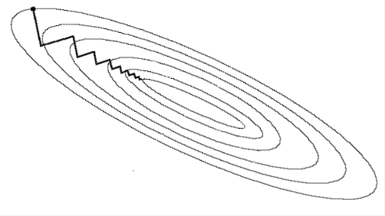
Geometrical Analysis of Steepest Descent
A sequence of residual multiples converges toward the solution, but successive residuals are orthogonal, resulting in a zig-zag pattern.
Steepest descent always makes a turn of 90 degrees as it moves toward the minimum, and it could very well be that a different turn is optimal.

Slide 16
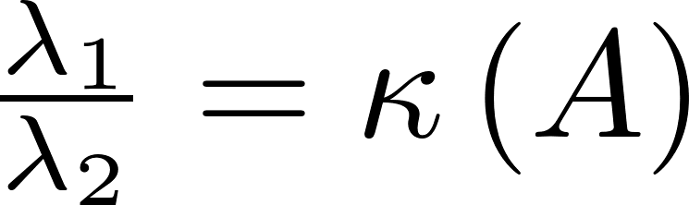
Geometrical Analysis of Steepest Descent
In R², the singular values of A are its eigenvalues, and the contour lines are ellipses. The eigenvalues are equal to the singular values and determine the semi-major and semi-minor axes of the ellipse. The ratio determines the shape of the ellipse. As the ratio becomes larger, the ellipse becomes long and narrow.

Slide 17
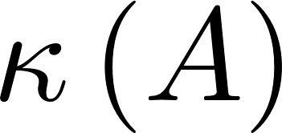
Geometrical Analysis of Steepest Descent
If is large, the paraboloid φ (x) has a steep, narrow canyon near the minimum, and the values of x_{i} move back and forth across the walls of the canyon, moving down very slowly, and requiring a great many iterations to converge to the minimum

Slide 18
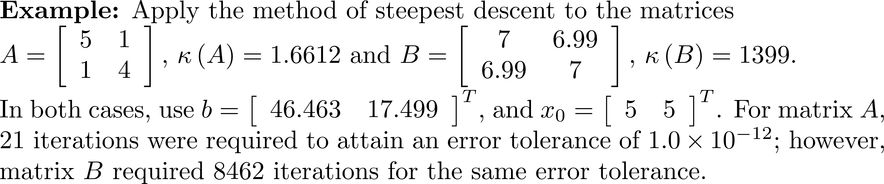
Example 1
A = [5 1;1 4];
B = [7 6.99;6.99 7];
b = [46.463 17.499]';
fprintf('The condition numbers of A and B respectively are:\n%g/%g\n',...
cond(A), cond(B));
tol = 1.0e-12;
x0 = [5 5]';
maxiter = 10000;
[~, ~, iter1] = steepestDescent(A,b,x0,tol,maxiter);
[~, ~, iter2] = steepestDescent(B,b,x0,tol,maxiter);
fprintf('Ax = b required %d iterations, and Bx = b required %d\n',...
iter1,iter2);
<Run>
The conditions numbers of A and B respectively are:
1.66117/1399
Ax = b required 21 iterations, and Bx = b required 8462

Slide 19
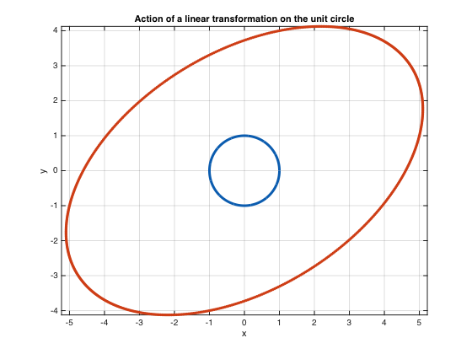
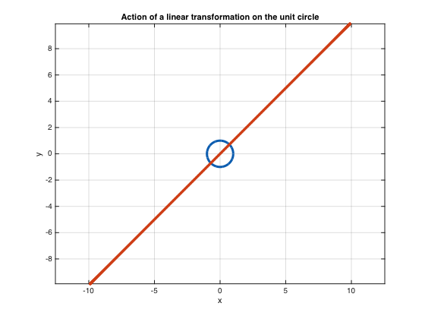
Example 1

Slide 20
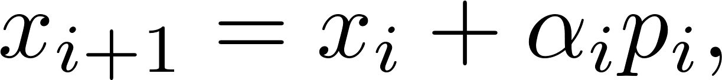
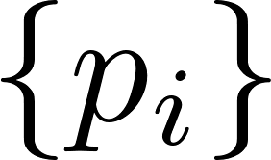
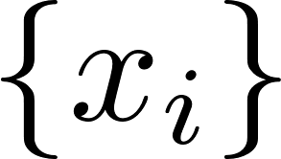
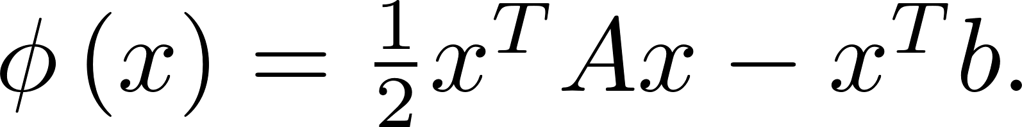
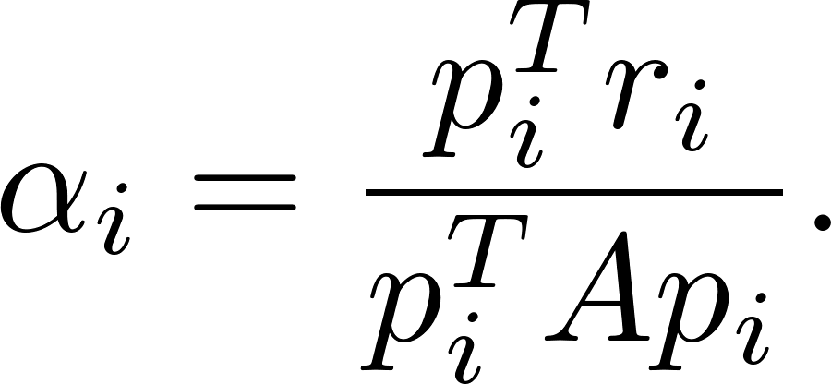
From Steepest Descent to Conjugate Gradient
The conjugate gradient (CG) method computes where the direction vectors are chosen so much more accurately and quickly descends toward the minimum of
Using the same argument as for steepest descent,

Slide 21
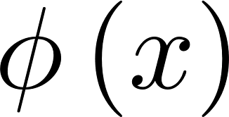
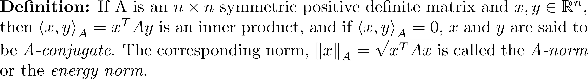
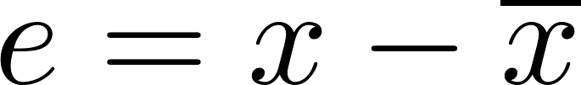
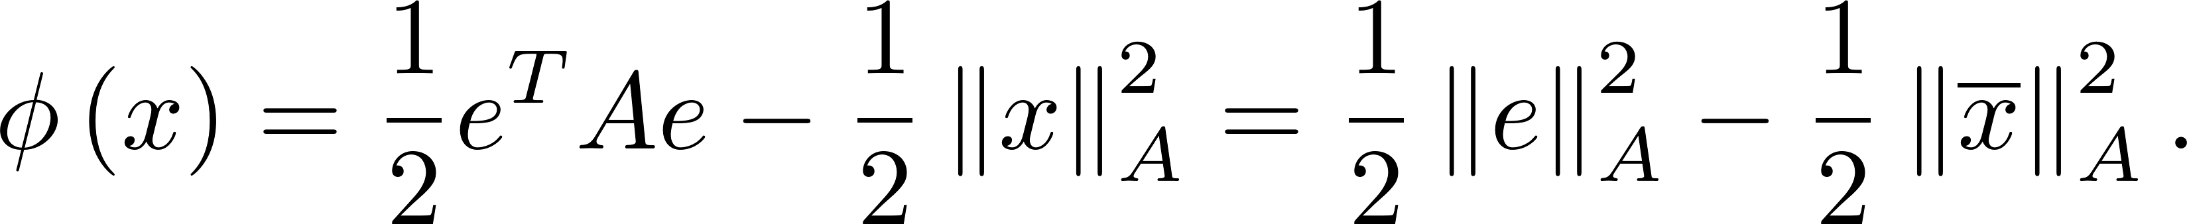
From Steepest Descent to Conjugate Gradient
CG approximates the minimum of using a different norm called the A-norm.
If is the error, then

Slide 22
From Steepest Descent to Conjugate Gradient
The steepest descent algorithm minimizes the 2-norm of the error along a gradient line at each step (one dimensional minimization).
The CG method uses information from past steps so that it can minimize over higher dimensional subspaces. In fact, in moving from x_{i-1} to x_{i}, the algorithm minimizes over an i-dimensional subspace.

Slide 23
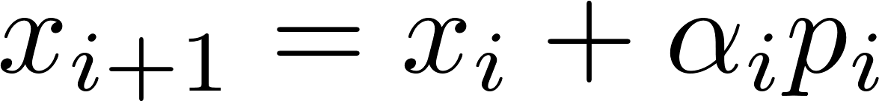
From Steepest Descent to Conjugate Gradient
The approximations do not zig-zag toward the minimum, but follow a shorter path.
Steepest descent
from from A in
four steps.
CG step from A.
Start

Slide 24
From Steepest Descent to Conjugate Gradient
Recall that the search directions (residuals), r_{i}, are orthogonal and thus linearly independent.
Recall that the Gram-Schmidt process takes a set of linearly independent vectors and produces a set of mutually orthogonal unit vectors relative to the 2-norm that span the same subspace as the original set.

Slide 25
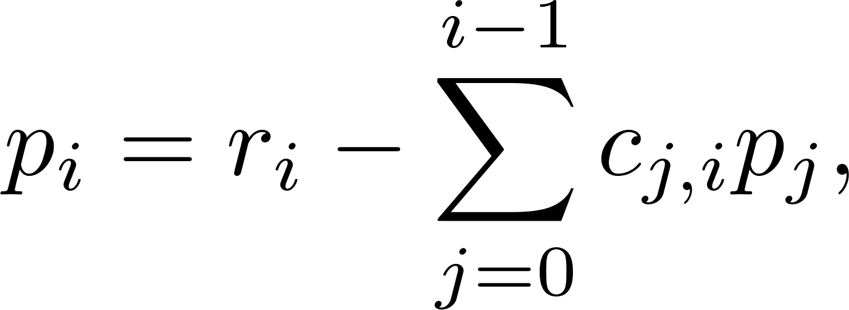
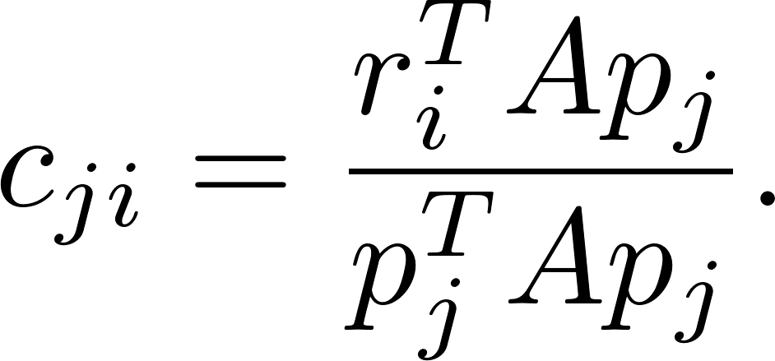
From Steepest Descent to Conjugate Gradient
Apply Gram-Schmidt to r₀, r₁, r₂, ..., r_{i-1}, but require orthogonality in the A-norm and do not normalize. The result is
It turns out that we get the benefit of a combination of search directions by computing only c_{i-1,i}, the coefficient of the last direction p_{i-1}!
Determine the next search direction
from the current residual and the
previous search directions.

Slide 26
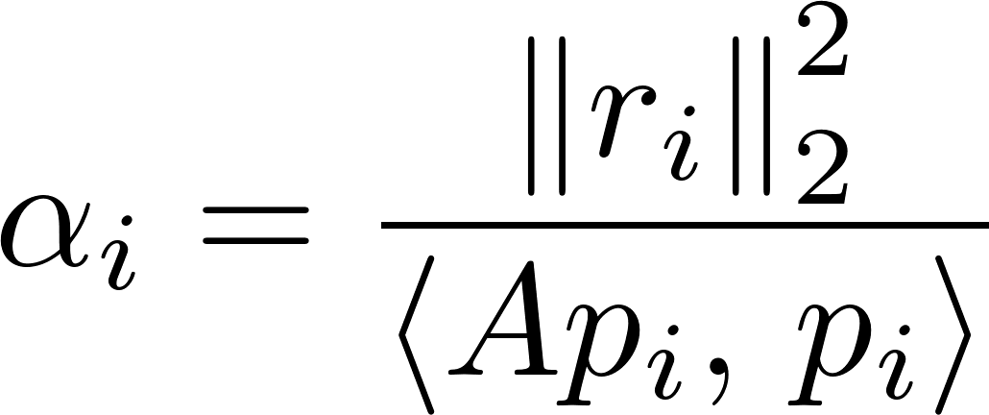
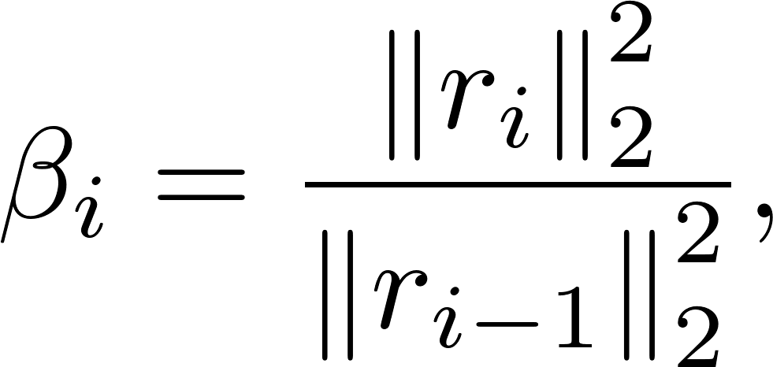
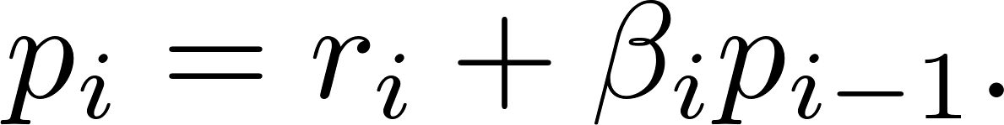
From Steepest Descent to Conjugate Gradient
After developing some lemmas and performing manipulation, the CG formulas are

Slide 27
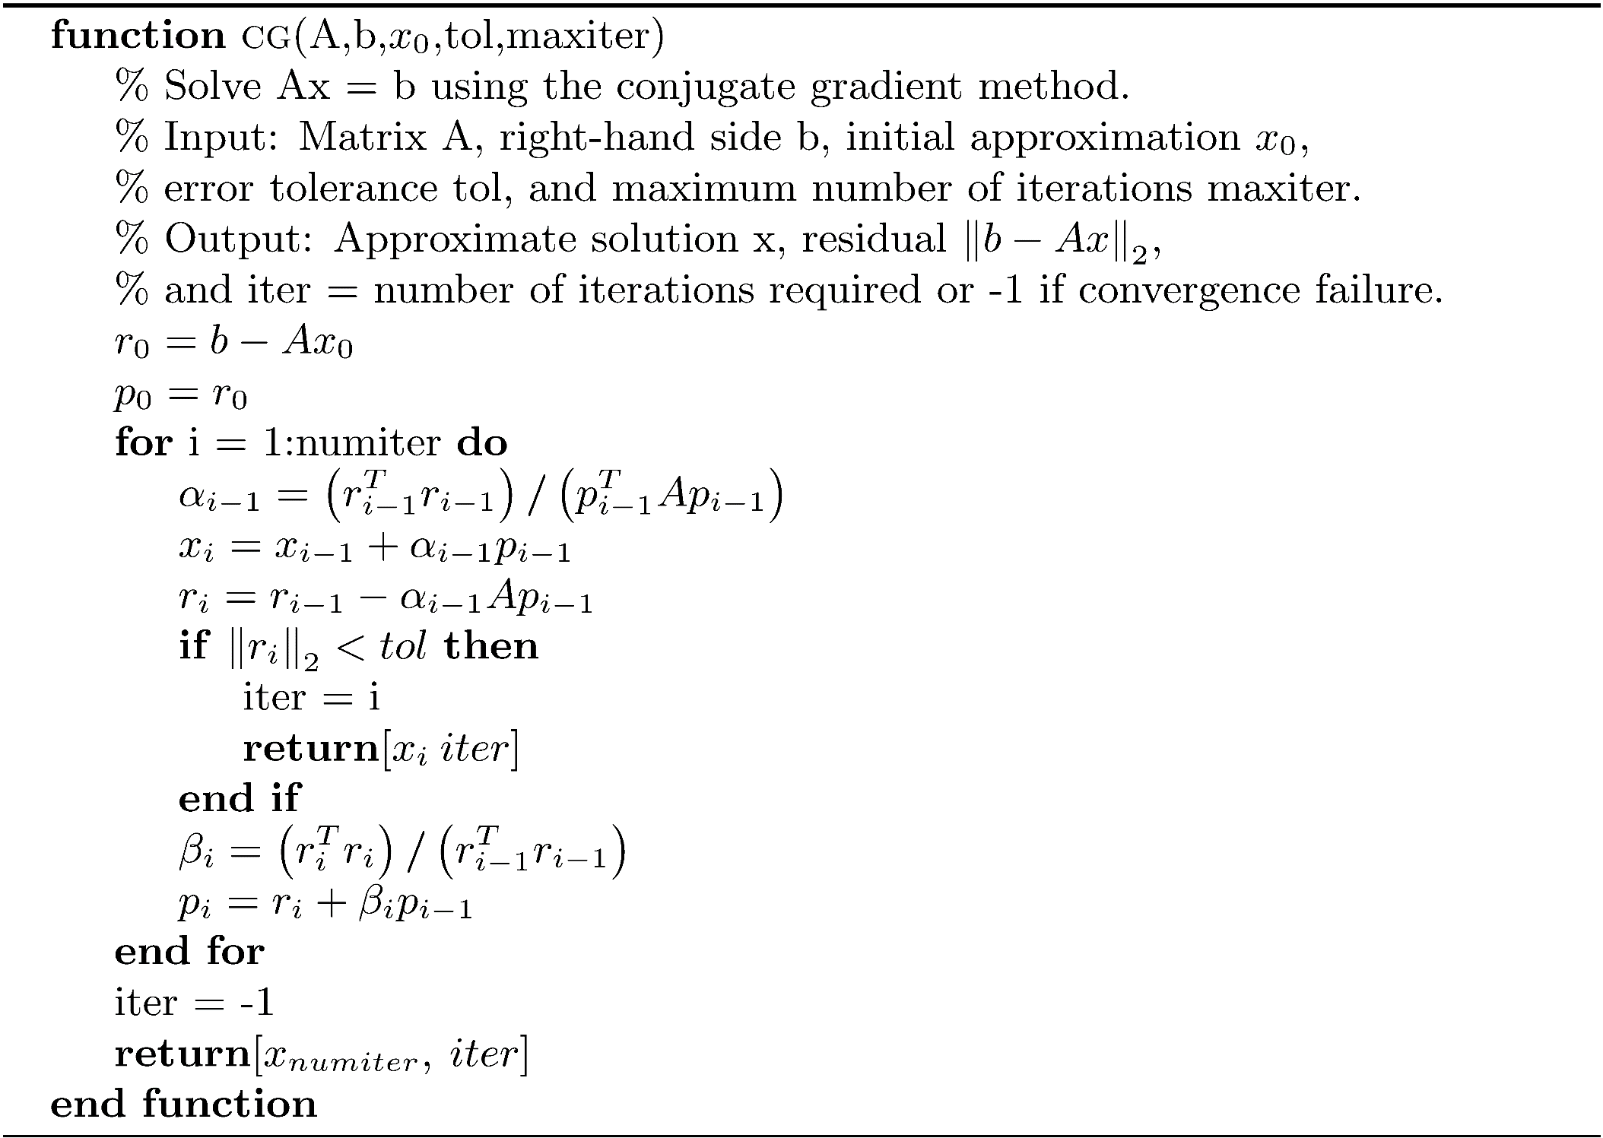
Algorithm cg

Slide 28
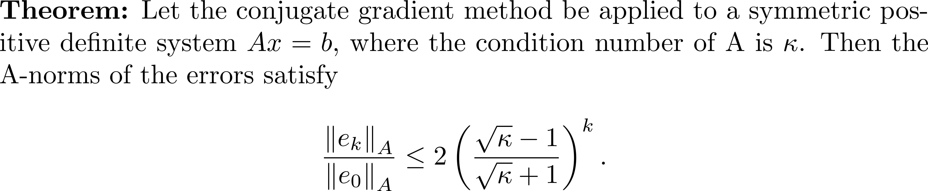
Convergence of CG

Slide 29
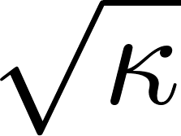

Convergence of CG
If is reasonably small, the algorithm will converge quickly, but if is large, convergence slows down. Since depends on the largest and smallest eigenvalue of A , if the eigenvalues are clustered closely together, convergence will be good. If the eigenvalues of A are widely separated, CG convergence will be slower.

Slide 30
Example 2
load 'CGDES.mat';
spy(CGDES);
fprintf('The condition number of CGDES is %.1f\n',cond(full(CGDES)));
b = rand(300,1);
x0 = ones(300,1);
numiter = 5:50;
n = length(numiter);
r_sdescent = zeros(n,1);
r_cg = zeros(n,1);
for i = 1:n
[~, r_sdescent(i)] = steepestDescent(CGDES,b,x0,1.0e-14,numiter(i));
[~, r_cg(i)] = cg(CGDES,b,x0,1.0e-14,numiter(i));
end
figure(2);
semilogy(numiter,r_sdescent,':k','LineWidth',2);
hold on;
semilogy(numiter,r_cg,'k','LineWidth',2);
xlabel('Number of iterations');
ylabel('Residual norm');
legend('Steepest descent','CG');
title('CG vs. steepest descent');

Slide 31
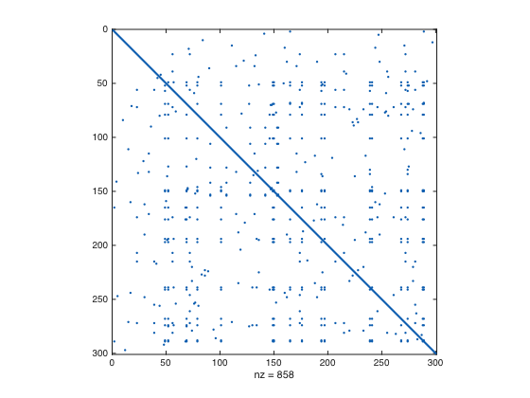
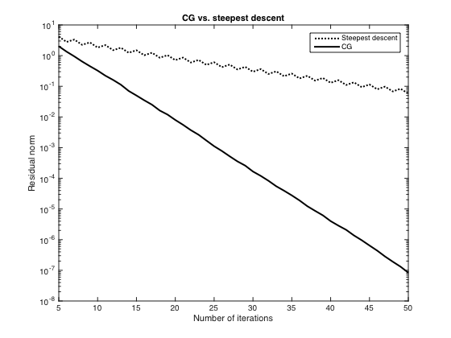
Example 2

Slide 32
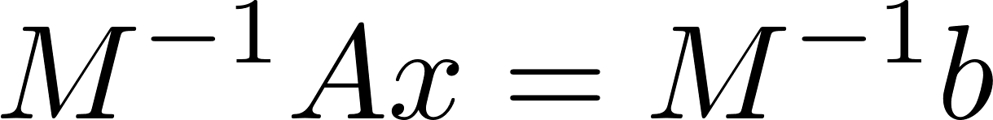
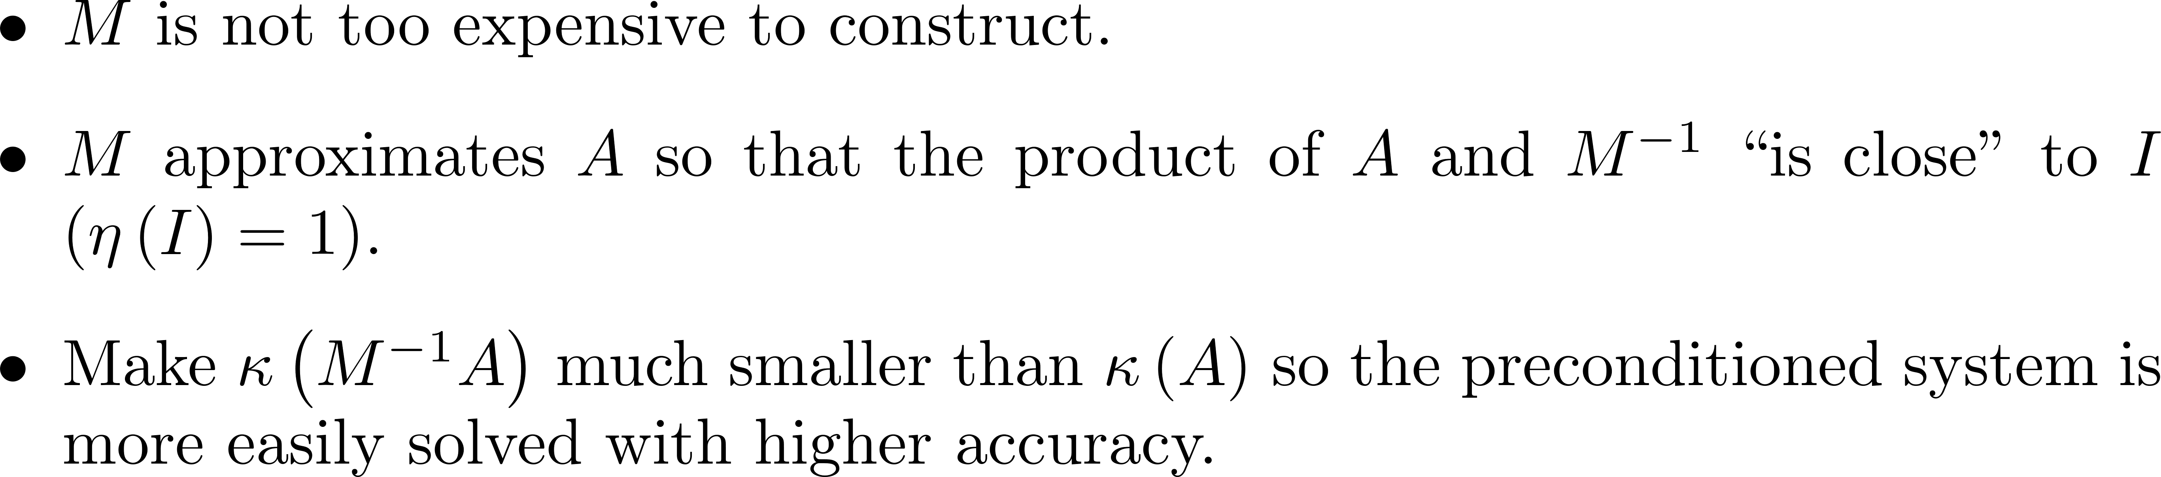
Preconditioning
Since the convergence of an iterative method depends on the condition number of the coefficient matrix, it is often advantageous to use a preconditioner matrix M that transforms the system Ax=b into having the same solution but that can solved more rapidly and accurately. Choose M so that

Slide 33
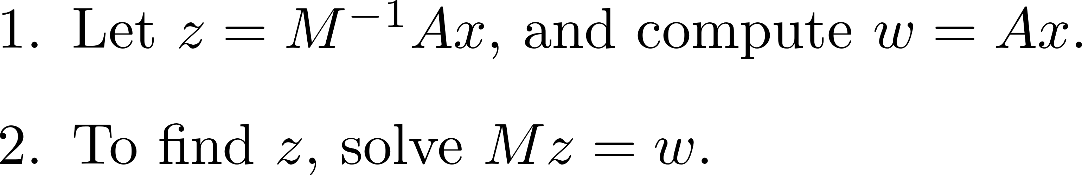
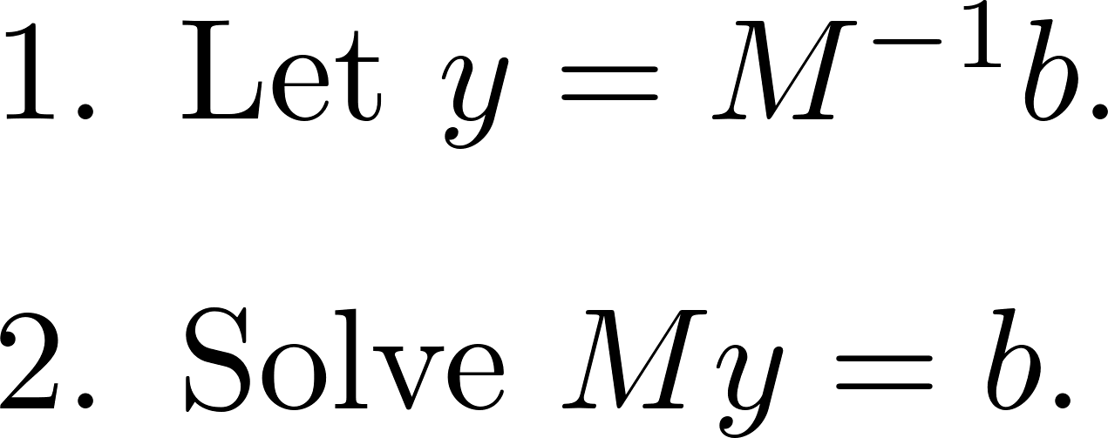
Preconditioning
M⁻¹ rarely needs to be computed. To evaluate M⁻¹A, proceed as follows:
Evaluate M⁻¹b using

Slide 34
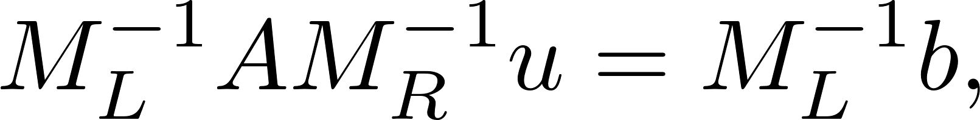
Types of Preconditioners
Matrix M such that M⁻¹A =M⁻¹b is termed a left-preconditioner.
Matrix M such that AM⁻¹(Mx) = b is termed a right-preconditioner.
Let u = Mx and solve AM⁻¹u = b.
If M = M_{L}M_{R} is a factorization of M, a split preconditioner can be used.
Write and solve where u = M_{R}x.

Slide 35
Preconditioning for CG
The preconditioned system must be symmetric positive definite. In the case of a left preconditioner, M⁻¹A must be positive definite.

Slide 36

Incomplete Cholesky Decomposition
Assume M is a symmetric positive definite matrix with Cholesky decomposition M = R^{T}R. Some computations show that the system M⁻¹A = M⁻¹b is equivalent to the system
NOTE: is symmetric positive definite.

Slide 37
Incomplete Cholesky Decomposition
The Cholesky factor R used in the equivalent system is usually less sparse than M.
685 x 685 positive definite matrix
used in a power network problem.
Cholesky factor

Slide 38
Incomplete Cholesky Decomposition
If an element a_{ij} off the diagonal of A is zero, the corresponding element r_{ij} is set to zero. The factor returned, R , has the same distribution of nonzeros as A above the diagonal.
Use M = R^{T}R with the hope that the condition number of M⁻¹A is considerably smaller than that of A .

Slide 39
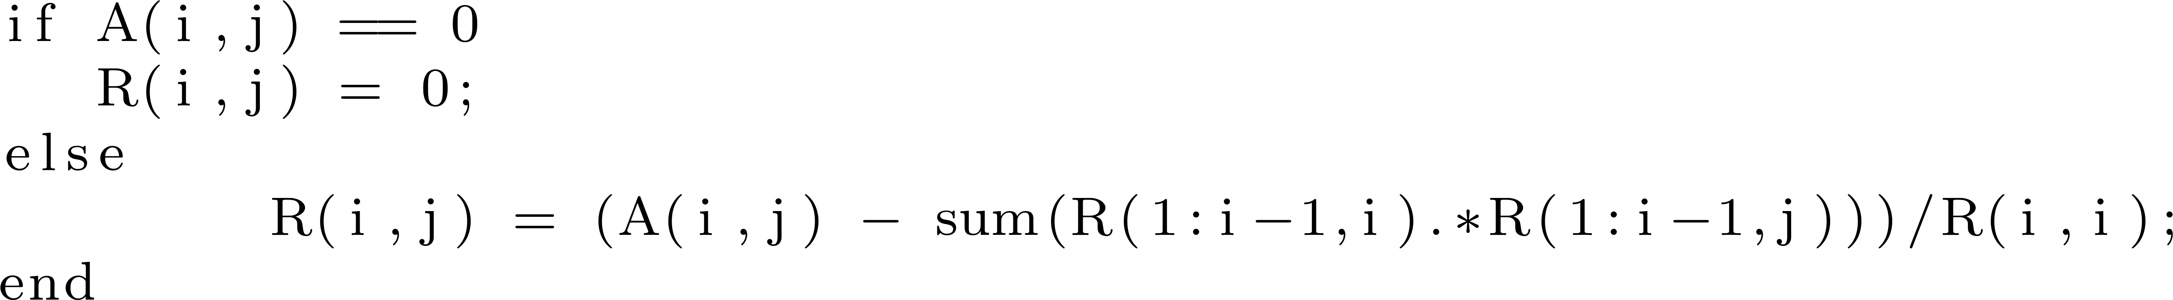
Incomplete Cholesky Decomposition
The function icholesky in the software distribution implements the incomplete Cholesky decomposition with the calling sequence R = icholesky(A).
Implement by replacing the inner loop of cholesky by
NOTE: This algorithm is said to perform zero-fill.

Slide 40
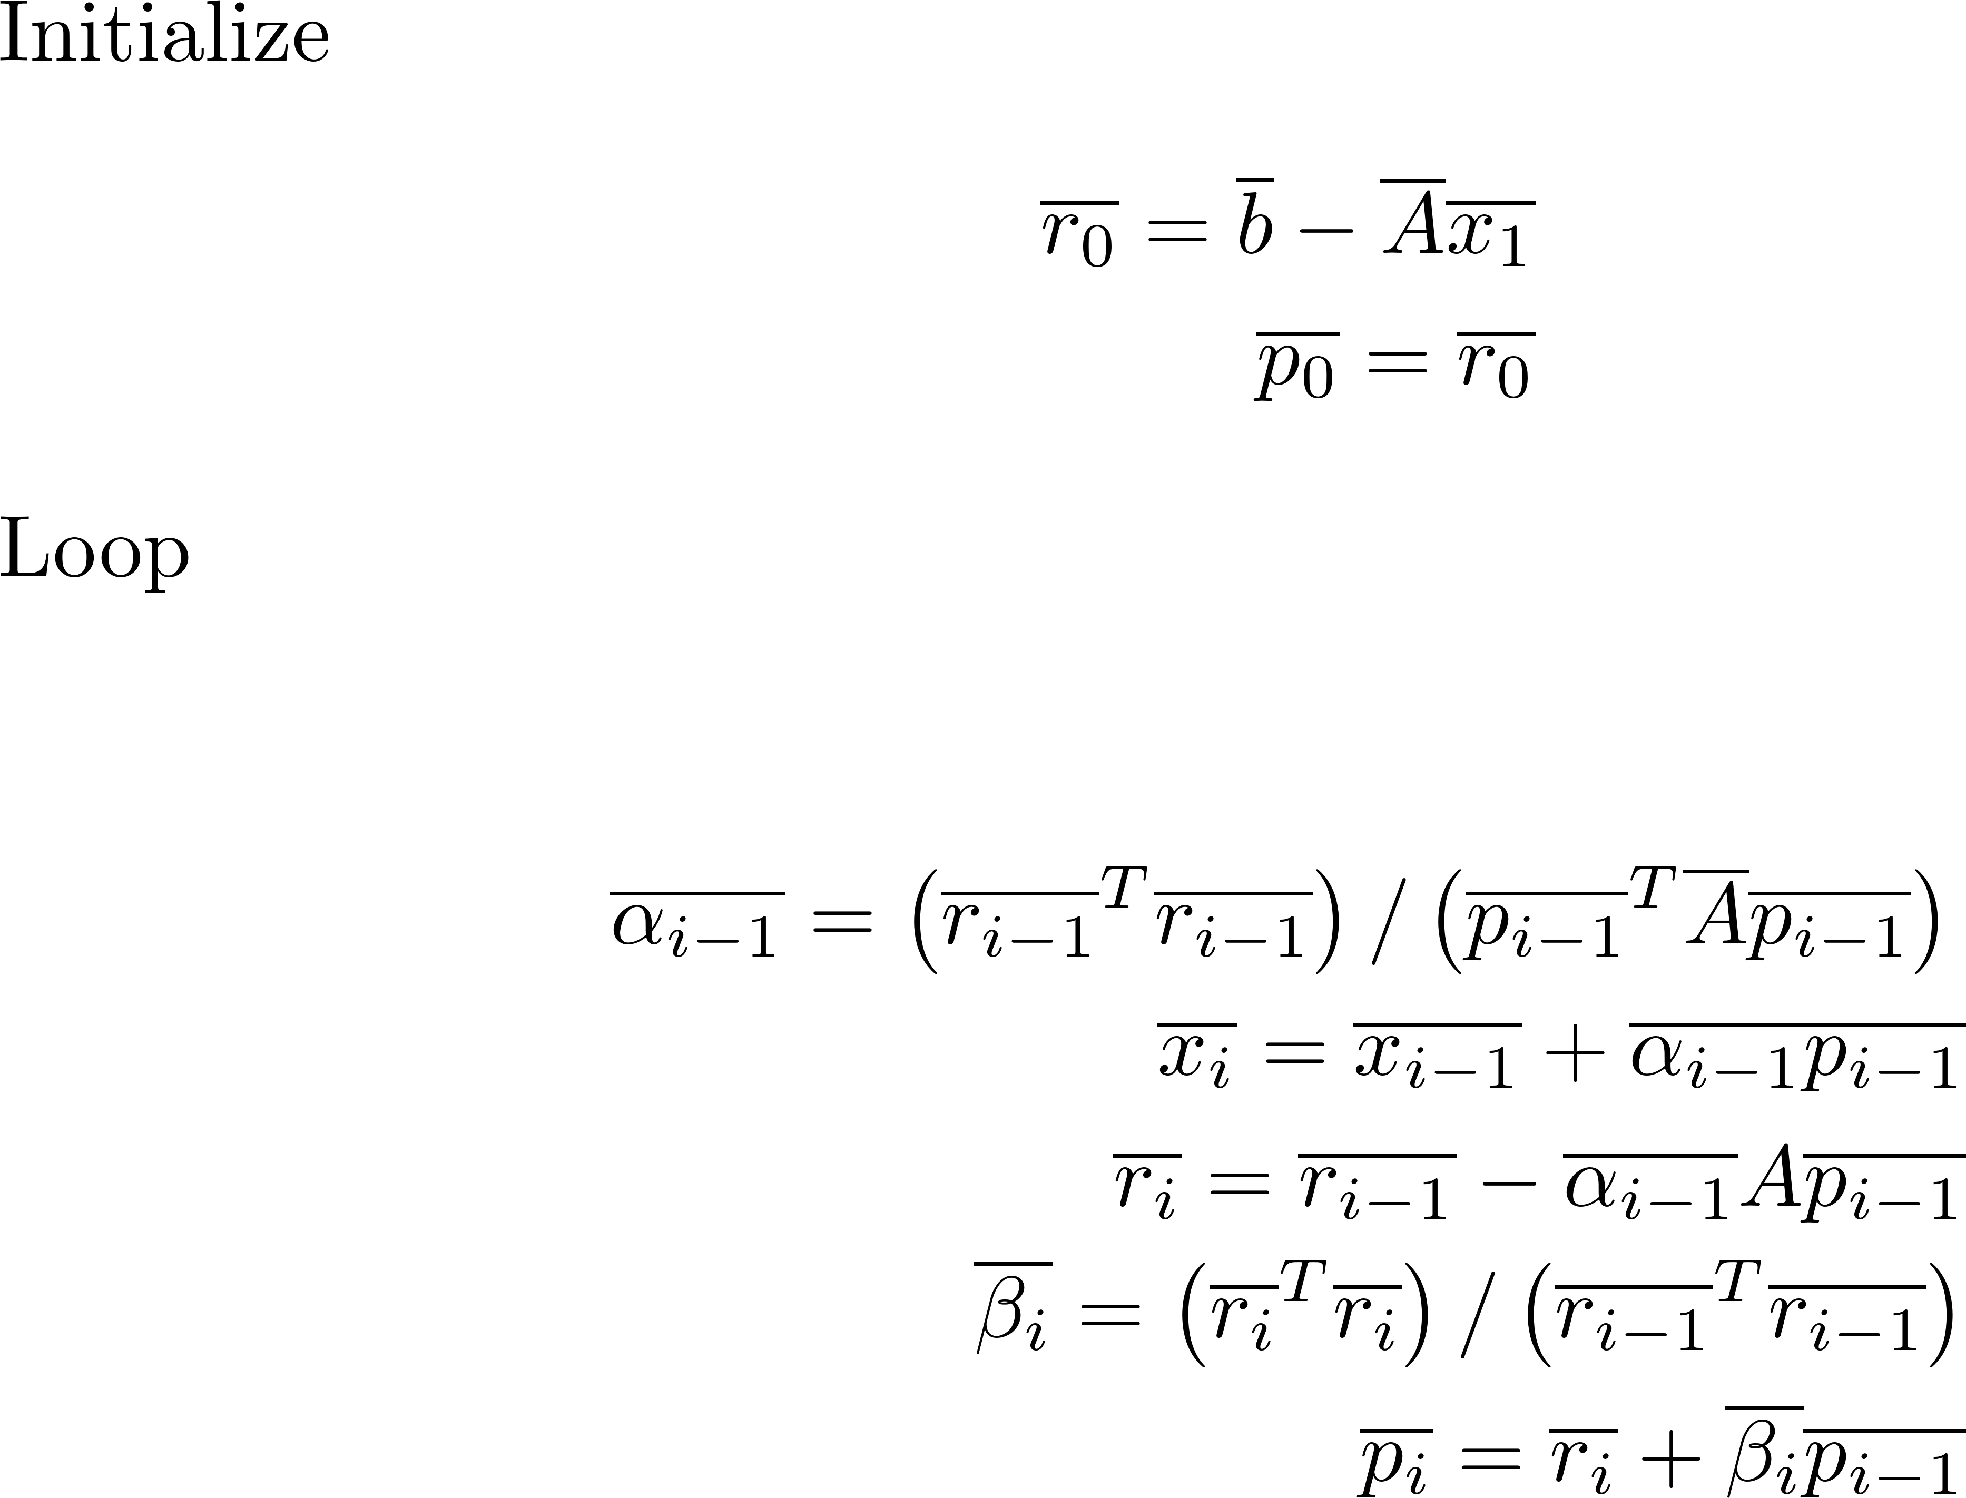
Incomplete Cholesky Decomposition
Can apply CG to the modified system

Slide 41
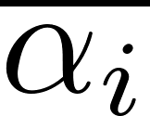

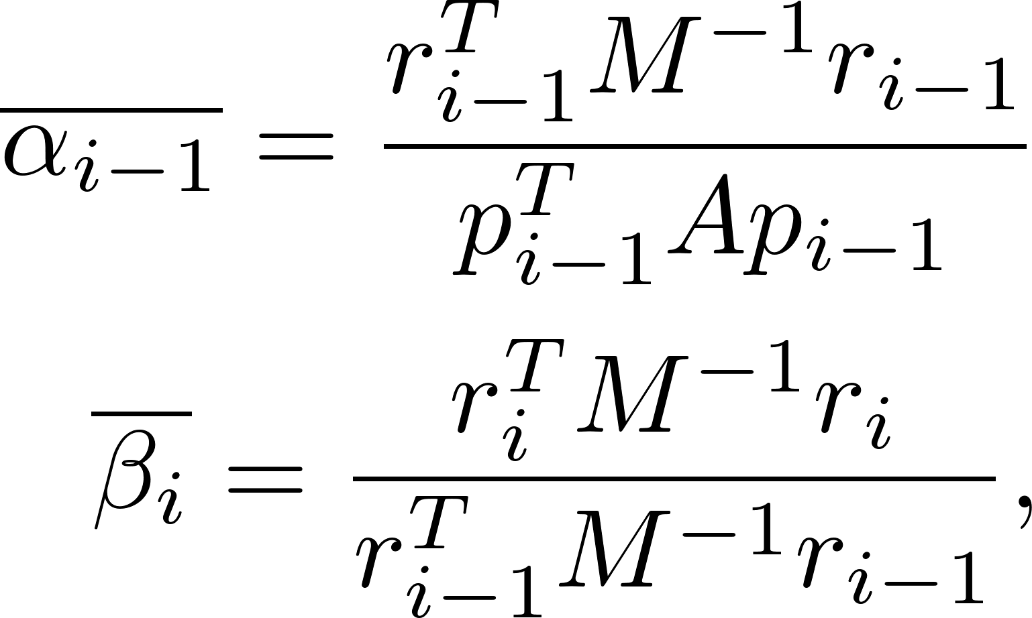
Incomplete Cholesky Decomposition
This is not efficient. After applying some mathematics, the and can be computed with and this leads to the preconditioned conjugate gradient algorithm.

Slide 42

Algorithm precg

Slide 43

Algorithm precg

Slide 44
MATLAB Implementation of precg
For a particularly difficult matrix, it is possible that the incomplete Cholesky decomposition will break down due to cancellation error.
The MATLAB function ichol attempts to handle this using a set of options, such as setting a drop tolerance.
At step j of the decomposition, elements which are smaller in magnitude than a local drop tolerance (norm(A(j:end,j),1)*droptol) are dropped from the resulting factor except for the diagonal element which is never dropped.
NOTE: The function precg in the software distribution uses ichol.

Slide 45
MATLAB Implementation of precg
Even with more advanced techniques, it still can be difficult to find an incomplete Cholesky preconditioner that works.

Slide 46

Example 3

Slide 47
Example 3

Slide 48



SSOR Preconditioner
The SOR iteration in matrix form is and this leads to If can be used as a preconditioner.
An SOR preconditioner is not symmetric and cannot be used for a symmetric positive definite matrix.

Slide 49




SSOR Preconditioner
To obtain a positive definite preconditioner, execute SOR in the forward direction to obtain Then perform SOR in reverse to obtain After elimination of the SSOR preconditioner matrix is
Symmetric positive definite.

Slide 50

SSOR Preconditioner
Using is effective in many cases and gives the matrix
The function precg in the book software distribution implements, in addition to incomplete Cholesky, SSOR preconditioning with . Its calling format is function [x, residual, iter] = precg(A,b,x0,tol,maxiter,method,droptol)
'incomplete Cholesky' or 'SSOR'
NOTE: droptol is only meaningful if incomplete Cholesky preconditioning is used.

Slide 51

Example 4

Slide 52
Krylov Subspace Methods
If the coefficient matrix is large, sparse, and symmetric positive definite, the method of choice is normally CG. However, in applications it is often the case that the coefficient matrix is symmetric but not positive definite or may not even be symmetric. There are sophisticated iterations for these problems, most of which are based on a Krylov subspace. A Krylov subspace-based method does not access the elements of the matrix directly, but rather multiplies vectors by the matrix and works with the resulting vectors that are projections into a lower-dimensional Krylov subspace. These methods can often give a good result after a relatively small number of iterations.

Slide 53

Krylov Subspace Methods

Slide 54
Krylov Subspace Methods
Although we approached the CG method using an optimization approach, CG is also a Krylov subspace method.

Slide 55


The Arnoldi Method
Our aim is to develop a method of solving a large, sparse system Ax=b , where A^{n×n} is a general nonsymmetric matrix. Approximate the solution by projecting the problem into a Krylov subspace where m is much smaller than n ( ) .
Obtaining the approximation to the system solution will be practical in this much smaller subspace

Slide 56

The Arnoldi Decomposition
The primary step in the Arnoldi method is to compute the Arnoldi decomposition of the square matrix A.
Begin with an initial vector x₁ and consider the Krylov subspace Use this to build the decomposition.
The set of vectors is not a well-conditioned basis (converges to an eigenvector of A), so apply Gram-Schmidt to form an orthonormal basis.

Slide 57



The Arnoldi Decomposition
By working with Gram-Schmidt, the result is the Arnoldi decomposition.
Assume A^{n x n} is a nonsingular square matrix and m < n. Then,
where Q_{m+1} is an n x (m+1) matrix with orthonormal columns,
Q_{m} = Q_{m+1}(:,1:m), and is the (m+1) x m upper Hessenberg matrix

Slide 58
The Arnoldi Decomposition

Slide 59

Algorithm arnoldi
Flop count: 2m²n

Slide 60




Alternative Form for the Arnoldi Decomposition

Slide 61

GMRES (General Minimum Residual)
Assume A is a real n × n matrix, b be an n × 1 vector, and we want to solve the system Ax=b. Assume that x₀ is an initial guess for the solution, and r₀ = b-Ax₀ is the corresponding residual.
Let where the columns of are an n-dimensional orthogonal basis for the Krylov subspace
Find y_{m} so that is minimum.

Slide 62







GMRES
Derivation of the GMRES algorithm.
First Arnoldi vector:
Let
Since the columns of Q_{m+1} are orthonormal,
Must minimize
Solve the (m+1) x m least squares problem
The approximate solution to Ax = b is
Use x_{m} as an improved initial vector and repeat the process until
satisfying a prescribed error tolerance.

Slide 63
QR Decomposition of an Upper Hessenberg Matrix
The coefficient matrix for the least-squares problem is upper Hessenberg. Take advantage of this by using Givens rotations to eliminate the entries in the subdiagonal. NLALIB provides the function givenshessqr for this purpose.

Slide 64
givenshessqr
function [Q, R] = givenshessqr(H)
%givenshessqr: QR factorization of an n x n upper Hessenberg
%matrix using Givens rotations.
%
% [Q R] = givenshessqr(H) For n x n upper Hessenberg matrix A,
% returns an n x n upper triangular matrix R and an n x n
% orthogonal upper Hessenberg matrix Q such that H = QR.
n = size(H,1);
Q = eye(n,n);
for i= 1:n-1
[c,s] = givensparms(H(i,i),H(i+1,i));
H = givensmul(H,i,i+1,c,s);
Q = givensmul(Q,i,i+1,c,s);
end
R = H;
Q = Q';

Slide 65

Algorithm gmres

Slide 66

Algorithm gmres

Slide 67
GMRES Notes
The choice of m is experimental. Try a small value and see if the desired residual norm can be attained. If not, increase m until obtaining convergence or finding that GMRES simply does not work.
As m increases , memory use and computational effort increase. It may happen that the problem is not tractable using GMRES.
There are other methods such as Bi-CG and QMR that may work.

Slide 68

Example 5

Slide 69

Preconditioned GMRES
In the same way that we used incomplete Cholesky as a preconditioner when A is symmetric positive definite, we can use the incomplete LU decomposition to precondition a general matrix. Compute factors L and U so that if element then the element at index (i,j) of A-LU is zero. In other words, perform the LU decomposition so that the pattern of nonzeros in LU is the same as that of A . It is hoped that if M=LU , then M⁻¹A will have a smaller condition number than A.

Slide 70

Algorithm ilub

Slide 71

Algorithm ilub

Slide 72



Applying Incomplete LU Decomposition
Solve the equivalent system
where
The function pregmres in the software distribution approximates
the solution to Ax=b using the equivalent system.

Slide 73


Applying Incomplete LU Decomposition
ilub will fail if there is a zero on the diagonal of U. In this case, it is necessary to use Gaussian elimination with partial pivoting. The software distribution contains a function mpregmres that computes the incomplete LU decomposition with partial pivoting by using the MATLAB function ilu. It returns a decomposition such that , so It is recommended that, in practice, mpregmres be used rather than pregmres.

Slide 74


Example 6
DK01R

Slide 75



The Symmetric Lanczos Method
The Lanczos decomposition is the Arnoldi decomposition applied to a symmetric matrix and, like the Arnoldi process, it can be written in two ways. T_{m} is a symmetric tridiagonal matrix, so T_{m} and have the form

Slide 76

The Symmetric Lanczos Method
In modifying the Arnoldi decomposition, the tridiagonal structure of T_{m} leads an inner loop of

Slide 77

Algorithm lanczos

Slide 78
Loss of Orthogonality with the Lanczos Process
Applying the Lanczos process is not as simple as it may seem.
Poor convergence can result from a bad choice of the starting vector, so a random vector is a good choice.
Using exact arithmetic, the vectors are mutually orthogonal. When implemented in finite precision arithmetic, roundoff error can cause lack or orthogonality among the vectors, with serious consequences.

Slide 79
Loss of Orthogonality with the Lanczos Process
One approach to fix this problem is to reorthogonalize as each new Lanczos vector is computed; in other words, orthogonalize twice. This is termed full reorthogonalization and is time-consuming but can be of great benefit.

Slide 80


Loss of Orthogonality with the Lanczos Process
Do the reorthogonalization by following with
In the software distribution, the function lanczos will perform full reorthogonalization by adding a fourth parameter of 1. The default is no reorthogonalization (0).

Slide 81

Example 7

Slide 82


Example 7

Slide 83
MINRES (Minimum Residual)
If a symmetric matrix is not positive definite, the conjugate gradient method does not apply. The minimum residual method (MINRES) is designed to apply in this case. In the same fashion as we developed the GMRES algorithm using the Arnoldi iteration, the MINRES method uses the Lanczos iteration. In the resulting least-squares problem, the coefficient matrix is tridiagonal, and the QR factorization is computed using Givens rotations.

Slide 84

Algorithm minres

Slide 85

Algorithm minres

Slide 86
Performance of MINRES
MINRES does well when a symmetric indefinite matrix is well-conditioned. The tridiagonal structure of H_{k} makes MINRES vulnerable to rounding errors. It has been shown that the rounding errors propagate to the approximate solution as the square of κ²(A) . For GMRES, the errors propagate as a function of κ(A) . Thus, if A is badly conditioned, try preconditioned GMRES.

Slide 87

Example 8

Slide 88
Example 8

Slide 89
Comparison of Iterative Methods
Given the tools developed, the following decision tree suggests an approach for choosing an iterative algorithm. Note that sometimes sparse matrix problems will defy proper solution using these techniques, and either other methods should be tried or the user must develop a custom preconditioner.

Slide 90


Poisson's Equation Revisited
Solve using finite difference equations
Must solve an (n-1)² x (n-1)² system over a grid.
Poisson's equation grid for n=4.

Slide 91


Poisson's Equation Revisited
When h= 1/n , the ( n-1)² × (n-1)² matrix for the numerical solution of Poisson's equation is the ill-conditioned block tridiagonal matrix where I is the (n-1) x (n-1) identity matrix, and T is the (n-1) x (n-1) tridiagonal matrix

Slide 92


The Biharmonic Equation
where
Applications:
Theory of elasticity
Mechanics of elastic plates
Slow flow of viscous fluids

Slide 93


The Biharmonic Equation
13-point central difference formula approximates
Approximate the normal derivative on each side of the square
by reflecting the first interior set of grid points across the boundary.

Slide 94


The Biharmonic Equation
The coefficient matrix is an ill-conditioned positive definite (n-1)² × (n-1)² block pentadiagonal matrix of the form
For n = 7, the blocks are

Slide 95
The Biharmonic Equation
36 x 36 Biharmonic Matrix

Slide 96

The Biharmonic Equation
For the solution is

Slide 97
The Biharmonic Equation
In the software distribution, the functions biharmonic_op and biharmonic build the biharmonic coefficient matrix and use the preconditioned conjugate gradient method to approximate the solution.

Slide 98


The Biharmonic Equation

